Slide 1

Cybersecurity Proposal for Headspace
Team

Slide 2

Overview
Goals & Objectives
Identify Cyber Risks/Threats to Headspace
Develop a Comprehensive Cybersecurity Plan
Implement the Cybersecurity Plan

Slide 3
Prioritize assets
App – THE MOST IMPORTANT ASSET
Data
Hardware
Software
Notes:
**Insert Diagram**

Slide 4
Asset management v.s. Account Management
Take Inventory of Hardware & Software Assets
a. Hardware Assets
i. Actively manage, track, and correct end-user devices, including portable and mobile; network devices;
B. Software Assets
ii. Actively manage inventory, track, and correct all software (operating systems and applications) on the network only authorized software is installed and can execute
HOW: Keep track of license expiration date and # of purchased licenses i.e, Windows, Excel? Implement an ‘Allow’ list which can be reassessed bi-annually. Otherwise employees must request permission
Multi-factor Authentication(MFA)-
Rather than just asking for a username and password, MFA requires the user to provide two or more verification factors (such as SMS text message with code) to gain access to accounts and the network.
HOW: use asset tags, decommission any unused hardware according to asset tag #
Notes:
1. Take Inventory of Hardware & Software Assets
a. Hardware Assets
i. Actively manage, track, and correct end-user devices, including portable and mobile; network devices; non-computing/Internet of Things (IoT) devices; and servers) connected to the infrastructure physically, virtually, remotely, and those within cloud environments, to accurately know how many assets need to be monitored and protected within the company.
HOW: use asset tags, decommission any unused hardware according to asset tag #
B. Software Assets
ii. Actively manage (inventory, track, and correct) all software (operating systems and applications) on the network so that only authorized software is installed and can execute, and that unauthorized and unmanaged software is found and prevented from installation.
HOW: Keep track of license expiration date and # of purchased licenses i.e, Windows, Excel? Implement an ‘Allow’ list which can be reassessed bi-annually. Otherwise employees must request permission

Slide 5
Risk management
Identifying Risks
Third Party Exposure
Unauthorized Risks
Corruption of Data
Poor Data Management
Strategies & Tactics
Mitigate Risks

Slide 6
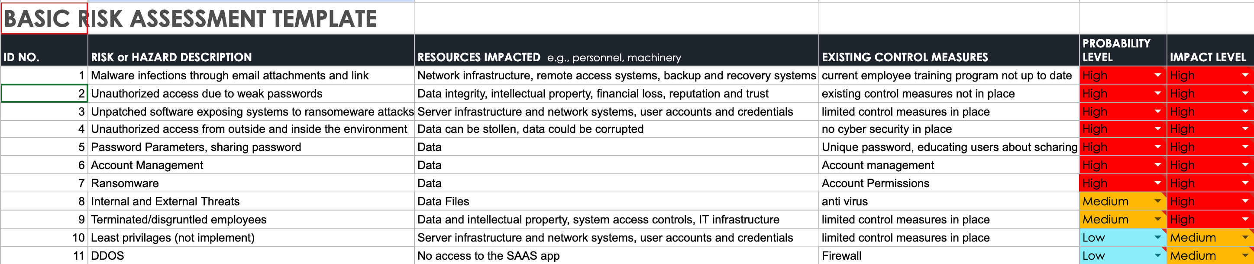
Prioritize risks
RISK ASSESSMENT
HIGH
  Malware infections through email attachments and links
MEDIUM
LOW
Notes:
*Insert Risk Chart*

Slide 7
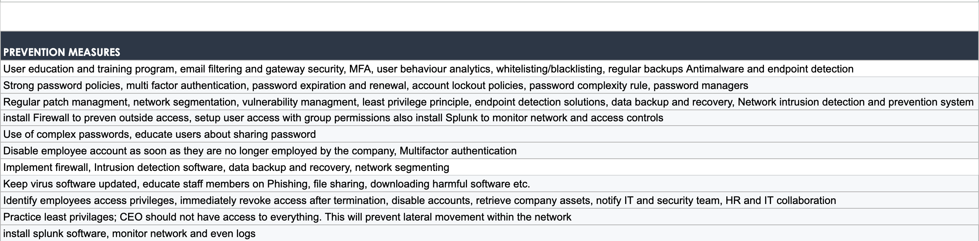
Risk mitigation

Slide 8
Framework GUIDELINES
NIST Framework
CIS Framework Cyber threat intelligence guidelines are received from Cybersecurity and Infrastructure Security Agency (CISA) information sharing forums and sources
Follow legal and regulatory requirements regarding cybersecurity (i.e, National Institutes of Standards and Technology [NIST],
Notes:
HIPPA

Slide 9
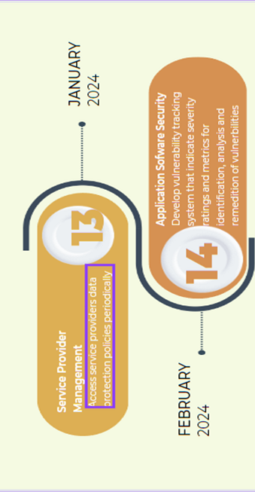
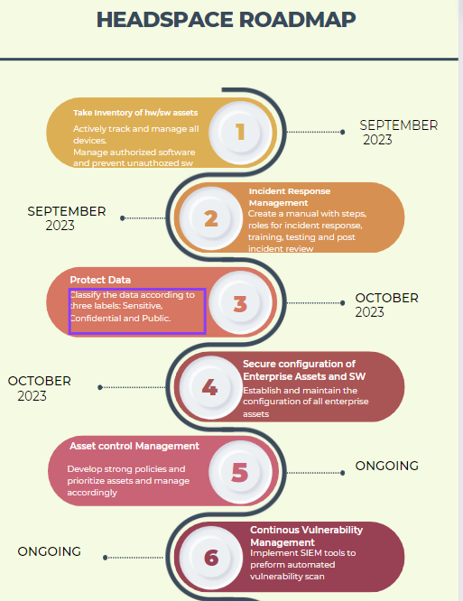
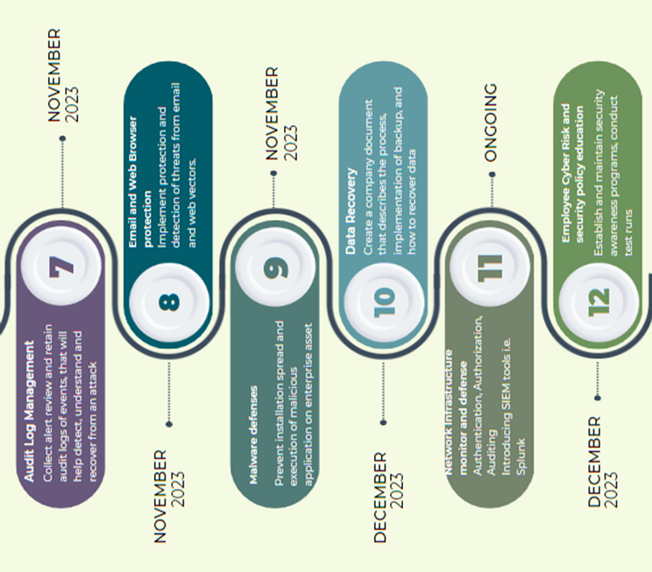
Timeline/Roadmap

Slide 10
Call to action
  EMPLOYEE EDUCATION- We will train employees on how to recognize/identify
    Social Engineering Tactics
    Phishing
  Run Simulations
  Security alert staff
  Secure Network and App
  Established protection, monitoring and response to Incidents.
  “TIME IS MONEY $$$, AND WE ARE SAVING YOU TIME, SO THEREFORE WE ARE SAVING YOU MONEY!” ☺
Notes:
Employee education
-

